Slide 1
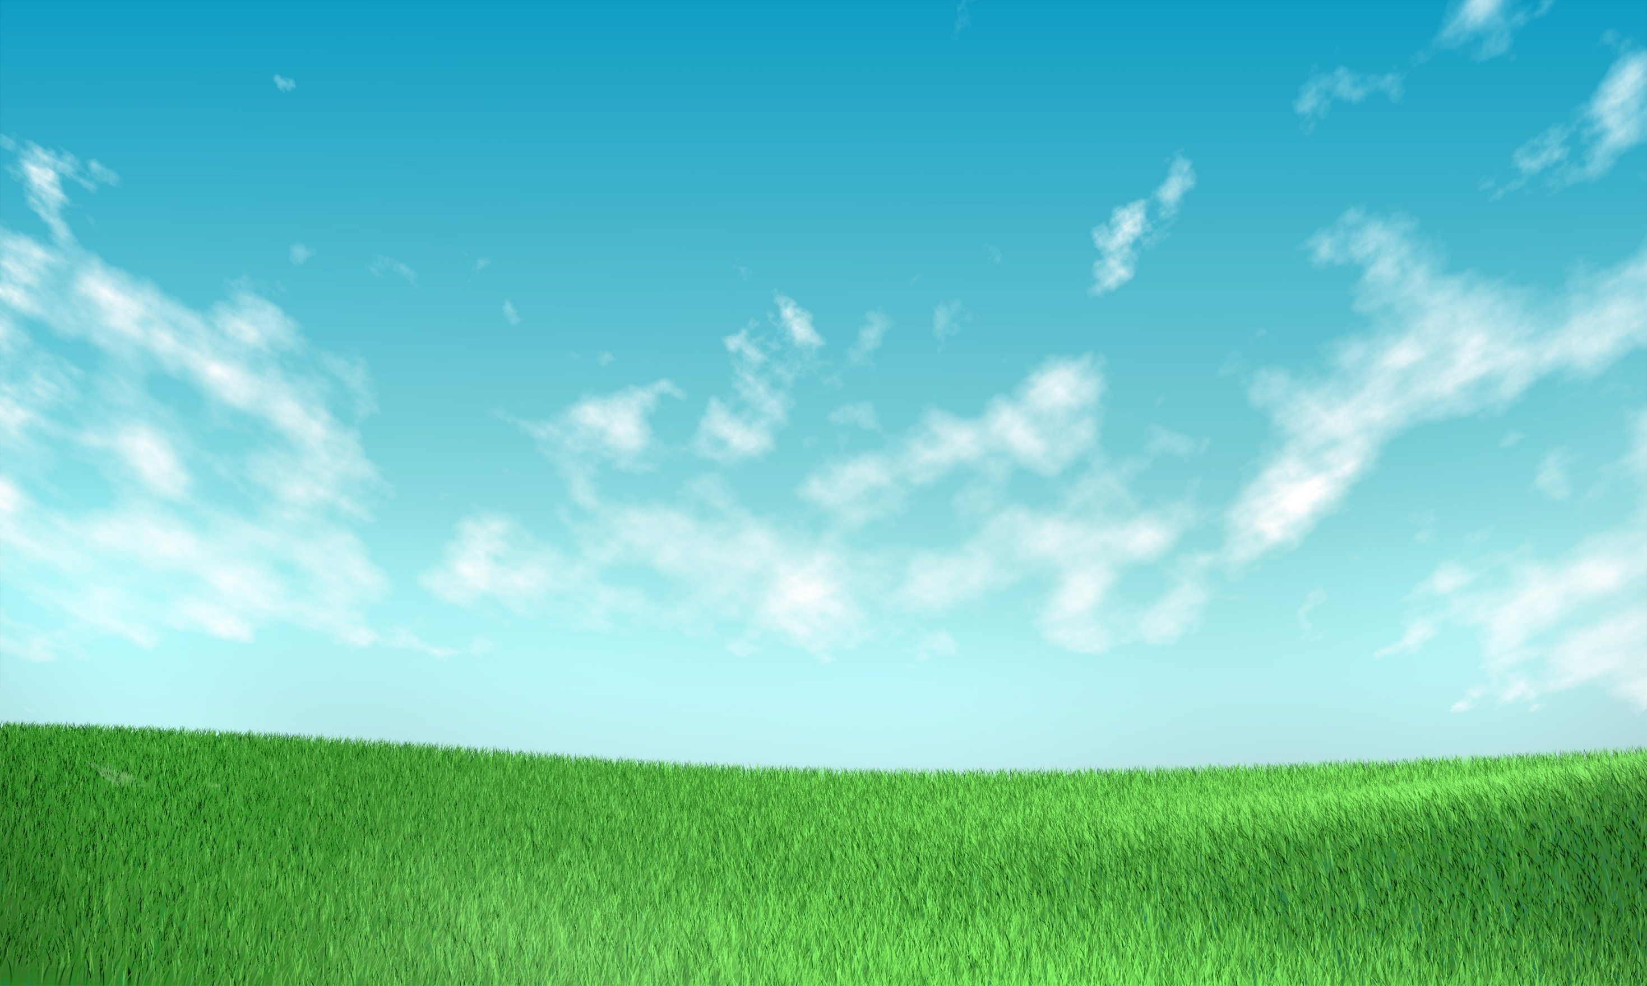
By: Mohamed Abdalla

Slide 2
World’s Problems
Green areas are getting smaller.
Increase in air pollution level.
Reduction of resources compared to population.
World Hunger.
Low economic level in developing countries.

Slide 3
Power of the People
Internet.
Social media.
One Goal: Save the Planet.

Slide 4
Green Baby
Sofia

Slide 5
Green Baby Garden
Sofia
Nicole
Marco

